Slide 1
HCI Definition
“Human-computer interaction is a discipline concerned with the design, evaluation and implementation of interactive computing systems for human use and with the study of major phenomena surrounding them”.
ACM SIGCHI Curricula for Human-Computer Interaction

Slide 2
HCI Definition
“HCI (human-computer interaction) is the study of how people interact with computers and to what extent computers are or are not developed for successful interaction with human beings”

Slide 3
Human-Computer Interaction
Human
  the end-user of a program
  the others in the organization
Computer
  The machine the program runs on
  Often split between clients and servers
Interaction
  the user tells the computer what they want
  the computer communicates results

Slide 4
Human-Computer Interaction
Task
Organization and Social Issues
Design
Technology
Humans

Slide 5
These Factors Influence Each
Other & Design
Now that mice are included with most computers, applications
assume a mouse will be used as a pointing device”
Task
Organization and Social Issues
Design
Technology
Humans

Slide 6
Factors Influence
“People change their knowledge as they perform, i.e., they learn”
Task
Organization and Social Issues
Design
Technology
Humans

Slide 7
Technology Change: different design needs
Need to be well designed
  Requirements of users
  Capabilities of users
Principles of Good HCI
  Visibility
    Controls need to be visible
    Good mapping of controls with its effects
  Affordance (Properties of objects)
    Suggest functionality

Slide 8
The Challenge of HCI
Rapid changes in Technology
  Inherent conflicts and trade-offs of design goals
  Different components
Development of Silicon Chip
Recent Development in Telecom
  ISDN
  High definition TV
Internet

Slide 9
The Challenge of HCI
How to keep in line with changes in Technology
How to ensure that their designs offer:
  Good HCI
  Functionality of the new technology

Slide 10
The Goals of HCI (Usability)
To produce usable and safe system
To develop or improve systems:
  Safety
  Utility
  Effectiveness
  Efficiency
  Usability (A key concept in HCI)
    Easy to learn and easy to use

Slide 11
Good Usability
Developer must attempt to:
  understand the factors that determine how people use technology
  develop tools and techniques to enable building suitable systems
  achieve efficient, effective, and safe interaction
  put people first

Slide 12
User Interfaces (UIs)
Part of application that allows users
  to interact with computer
  to carry out their task
HCI = design, prototyping, evaluation, &
implementation of UIs

Slide 13
Why Study User Interfaces?
Major part of work for “real” programs
  approximately 50%
You will work on “real” software
  intended for users other than yourself
Bad user interfaces cost
User interfaces hard to get right
  people are unpredictable

Slide 14
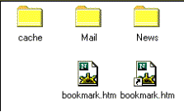
Bad User Interfaces
Hard to tell the difference between the two icons and names

Slide 15
Who builds UIs?
A team of specialists (ideally)
  graphic designers
  interaction / interface designers
  technical writers
  Marketers
  test engineers
  software engineers
  users

Slide 16
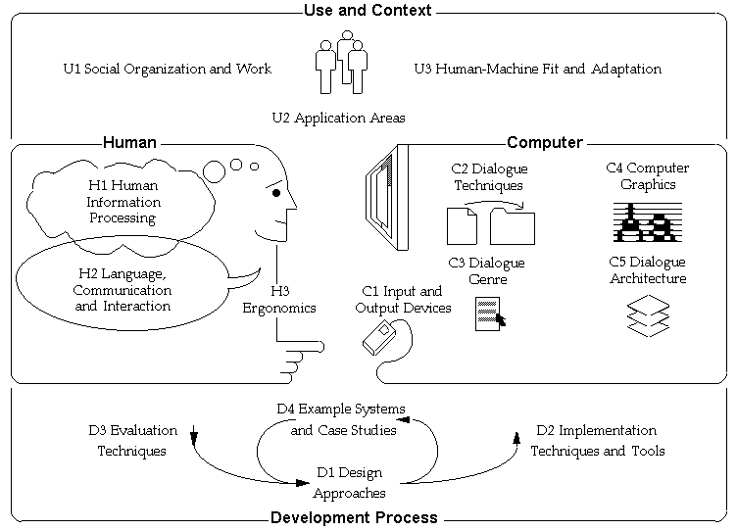
Topics in HCI

Slide 17
History of HCI:
much of the important work in Human-Computer Interaction rooted in university research not in industry
earliest and most influential HCI research:
  direct manipulation, the mouse pointing device, and windows;
  application areas, such as drawing, text editing and spreadsheets;
  gesture recognition, multimedia, and 3D;
  user interface management systems, toolkits, and interface builders.

Slide 18
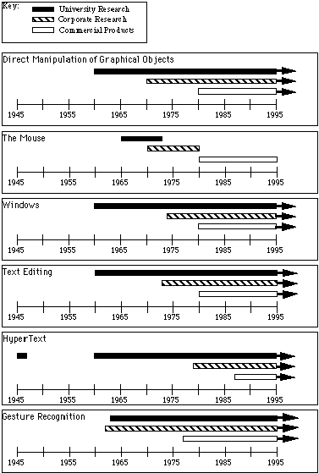

Slide 19
Direct Manipulation of graphical objects:
1963, Ivan Sutherland’s Sketchpad supported the manipulation of objects using a light-pen - a Ph.D thesis in MIT.
1966-67, William Newman's Reaction Handler provided direct manipulation of graphics, and introduced "Light Handles," a form of graphical potentiometer(a device for measuring differences in electrical potential)-research in Imperial College, London.
1975, David Canfield Smith coined the term "icons" – Ph.D thesis in Stanford.
1981,1982, 1984, Xerox Star ,the Apple Lisa and Macintosh, first commercial systems to make extensive use of Direct Manipulation

Slide 20
The Mouse:
1965, NLS project (funding from ARPA, NASA, and Rome ADC) at Stanford Research Laboratory (now SRI) - cheap replacement for light-pens, which had been used at least since 1954
Many of the current uses of the mouse were demonstrated by Doug Engelbart as part of NLS in a movie created in 1968.
The mouse was then made famous as a practical input device by Xerox PARC in the 1970's.
It first appeared commercially as part of the Xerox Star (1981), the Three Rivers Computer Company's PERQ (1981) , the Apple Lisa (1982), and Apple Macintosh (1984).

Slide 21
Windows:
Engelbart's NLS 1968, at Stanford on systems like COPILOT (1974) and at MIT with the EMACS text editor (1974)
Alan Kay proposed the idea of overlapping windows in his 1969 University of Utah PhD thesis
The main commercial systems popularizing windows were the Xerox Star (1981), the Apple Lisa (1982), and most importantly the Apple Macintosh (1984).

Slide 22
Drawing programs: Much of the current technology was demonstrated in Sutherland's 1963 Sketchpad system. The use of a mouse for graphics was demonstrated in NLS (1965).
Text Editing: In 1962 at the Stanford Research Lab, Engelbart proposed, and later implemented, a word processor with automatic word wrap, search and replace, user-definable macros, scrolling text, and commands to move, copy, and delete characters, words, or blocks of text.
Spreadsheets: The initial spreadsheet was VisiCalc which was developed by Frankston and Bricklin (1977-8) for the Apple II while they were students at MIT and the Harvard Business School.

Slide 23
HyperText: The idea for hypertext (where documents are linked to related documents) is credited to Vannevar Bush's famous MEMEX idea from 1945
Ted Nelson coined the term "hypertext" in 1965
Engelbart's NLS system at the Stanford Research Laboratories in 1965 made extensive use of linking (funding from ARPA, NASA, and Rome ADC).
The "NLS Journal" was one of the first on-line journals, and it included full linking of articles (1970).

Slide 24
Computer Aided Design (CAD): The same 1963 IFIPS conference at which Sketchpad Doug Ross's Computer-Aided Design Project at MIT in the Electronic Systems Lab and Coons' work at MIT with SketchPad
Video Games: The first graphical video game was probably SpaceWar by Slug Russel of MIT in 1962 for the PDP-1 including the first computer joysticks.
Gesture Recognition: Teitelman in 1964 developed the first trainable gesture recognizer, Tom Ellis' GRAIL system on the RAND tablet (1964, ARPA funded).
Multi-Media: The FRESS project at Brown used multiple windows and integrated text and graphics (1968, funding from industry).

Slide 25
3-D: Timothy Johnson's 3-D CAD system (1963, funded by the Air Force), "Lincoln Wand" by Larry Roberts was an ultrasonic 3D location sensing system, developed at Lincoln Labs (1966, ARPA funded)
Virtual Reality and "Augmented Reality": The original work on VR was performed by Ivan Sutherland when he was at Harvard (1965-1968, funding by Air Force, CIA, and Bell Labs).
Computer Supported Cooperative Work. Doug Engelbart's 1968 demonstration of NLS

Slide 26
Forces shaping future of HCI
larger memories and faster systems
Miniaturization of hardware and power requirements
New display technologies
Assimilation of computation into the environment
Specialized hardware
network communication and distributed computing.
widespread use of computers
innovation in input techniques
Wider social concerns

Slide 27
Future of HCI:
Communication.
High functionality systems.
Mass availability of computer graphics.
Mixed media.
Large and thin displays.
Embedded computation.
Group interfaces.
User Tailorability.
Information Utilities.

Slide 28
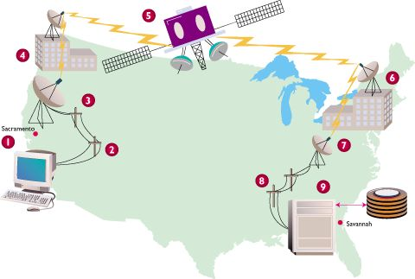
Communication
Computers will communicate through high speed local networks, nationally over wide-area networks, and portably via infrared, ultrasonic, cellular, and other technologies. Data and computational services will be portably accessible from many if not most locations to which a user travels.

Slide 29
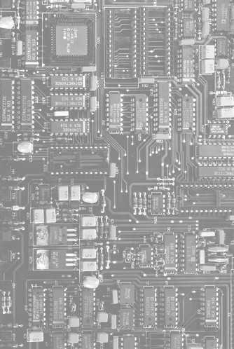
High functionality systems.
Systems will have large numbers of functions associated with them. There will be so many systems that most users, technical or non-technical, will not have time to learn them in the traditional way (e.g., through thick manuals).

Slide 30
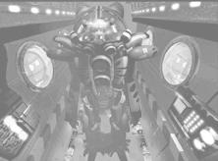
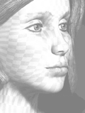
Mass availability of computer graphics.
  Computer graphics capabilities such as image processing, graphics transformations, rendering, and interactive animation will become widespread as inexpensive chips become available for inclusion in general workstations.

Slide 31
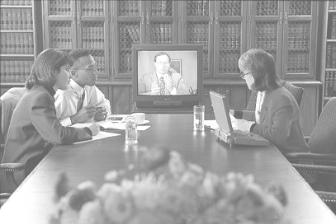
Mixed media.
  Systems will handle images, voice, sounds, video, text, formatted data. These will be exchangeable over communication links among users. The separate worlds of consumer electronics (e.g., stereo sets, VCRs, televisions) and computers will partially merge.

Slide 32
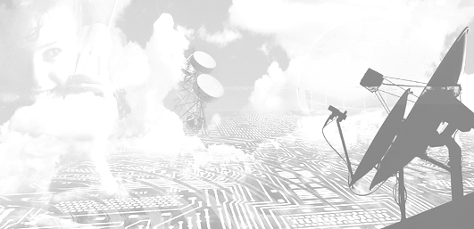
High-bandwidth interaction.
  The rate at which humans and machines interact will increase substantially due to the changes in speed, computer graphics, new media, and new input/output devices. This will lead to some qualitatively different interfaces, such as virtual reality or computational video.

Slide 33
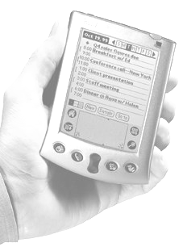
Large and thin displays.
  New display technologies will finally mature enabling very large displays and also displays that are thin, light weight, and have low power consumption. This will have large effects on portability and will enable the development of paper-like, pen-based computer interaction systems very different in feel from desktop workstations of the present.

Slide 34
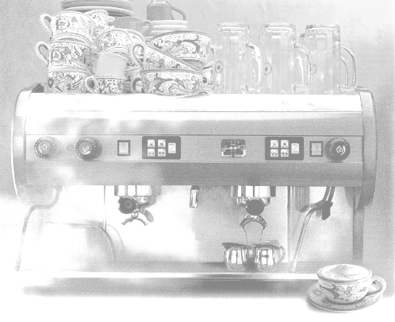
Embedded computation.
Computation will pass beyond desktop computers into every object for which uses can be found. The environment will be alive with little computations from computerized cooking appliances to lighting and plumbing fixtures to window blinds to automobile braking systems to greeting cards.

Slide 35
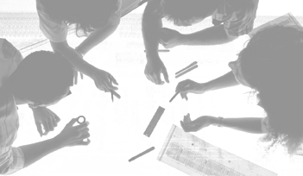
Group interfaces.
  Interfaces to allow groups of people to coordinate will be common (e.g., for meetings, for engineering projects, for authoring joint documents). These will have major impacts on the nature of organizations and on the division of labor. Models of the group design process will be embedded in systems and will cause increased rationalization of design.

Slide 36
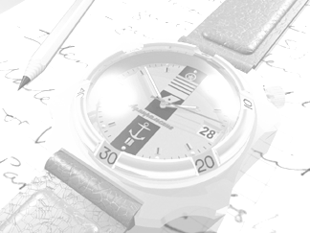
User Tailorability.
  Ordinary users will routinely tailor applications to their own use and will use this power to invent new applications based on their understanding of their own domains.

Slide 37
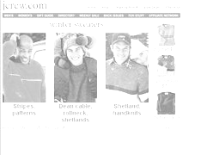
Information Utilities.
Public information utilities (such as, home banking and shopping, etc.) and specialized industry services (e.g., weather for pilots) will continue to proliferate. The rate of proliferation will accelerate with the introduction of high-bandwidth interaction and the improvement in quality of interfaces.

Slide 38
References
[1] Hewett, T. T., Baecker, R., Card, S. and et. al. (1996). Report of the ACM Special Interest Group (SIG) on Computer-Human Interaction Curriculum Development Group: Curricula for Human-Computer Interaction (the web version) . http://www.acm.org/sigchi/cdg/.
[2] Jenny Preece, Yvonne Rogers and et. al,, Human-computer interaction, (Wokingham: Addison-Wesley, 1994).
[3] Brad A. Myers. "A Brief History of Human Computer Interaction Technology." ACM interactions. Vol. 5, no. 2, March, 1998. pp. 44-54.

